Slide 1



HEALTH STREAM TELEMEDICINE
Parvathy Venugopal- Database Engineer​
Anshu Kumar Gatla- Data Pipeline Engineer​
Nischitha Purushotham- Data Analytics Engineer​
Bhavishya Gottipati- Power BI Engineer

Slide 2
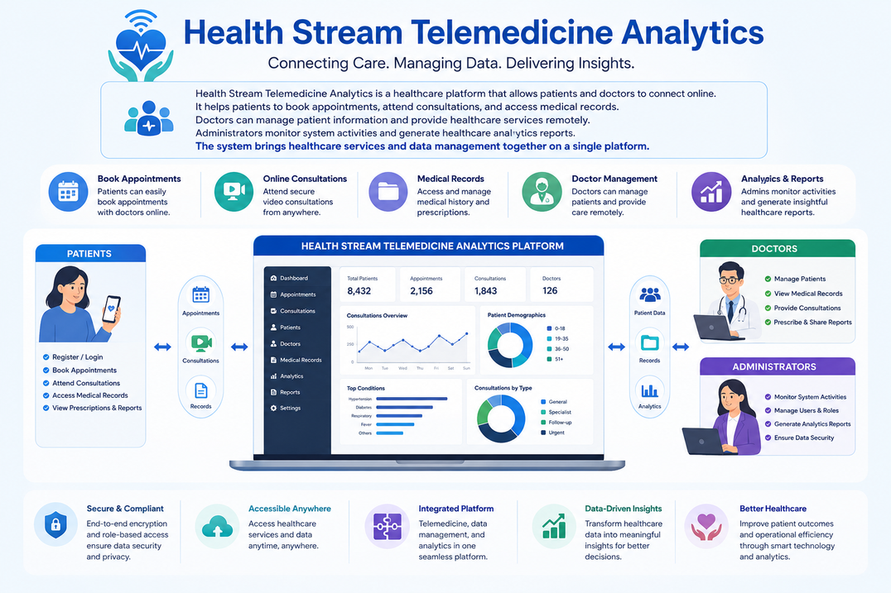
INTRODUCTION
Health Stream Telemedicine Analytics is a healthcare platform that allows patients and doctors to connect online. It helps patients to book appointments, attend consultations, and access medical records. Doctors can manage patient information and provide healthcare services remotely. Administrators monitor system activities and generate healthcare analytics reports. The system brings healthcare services and data management together on a single platform.

Slide 3



PROBLEM STATEMENT
CHALLENGES IN TRADITIONAL HEALTHCARE SYSTEMS
Delayed healthcare monitoring
Lack of real-time analytics
Difficulty handling large healthcare datasets
Absence of centralized monitoring systems
Inefficient healthcare data processing

Slide 4
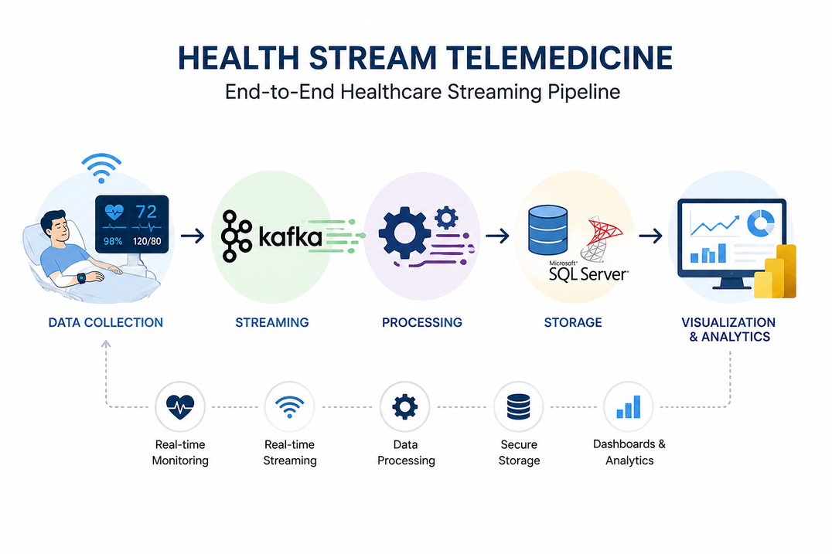
PROJECT OVERVIEW & OBJECTIVES
Health Stream Telemedicine focuses on real-time healthcare data processing.
Simulates continuous patient health monitoring.
Uses data engineering tools for streaming, processing, storage, and visualization.
Goal: Build an end-to-end healthcare streaming pipeline.
OBJECTIVES
Collect and process healthcare data
Stream data in real time using Apache Kafka
Store healthcare records in SQL Server
Create streamlined dashboards
Analyze healthcare trends
Develop dashboards using Power BI

Slide 5
DATASET & TECHNOLOGIES USED
Dataset Information
Dataset Includes
1
3
Healthcare patient monitoring dataset collected from Kaggle.
Patient ID
Heart Rate
Blood Pressure
Temperature
Battery Level
Health Status
Technologies Used
4
Python
Pandas
Apache Kafka
SQL Server
Streamlit
Power BI

Slide 6
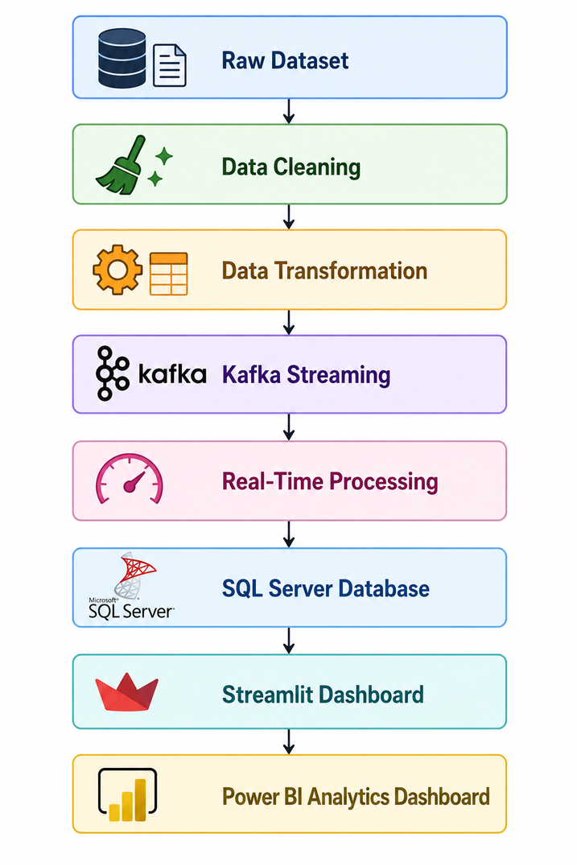
SYSTEM ARCHITECTURE

Slide 7
DATA PREPROCESSING
Data Cleaning & Preparation
Workflow
Removed null values
Removed duplicate records
Standardized healthcare data
Converted dataset into structured format
Prepared data for real-time streaming
Raw Dataset
|
Cleaned Dataset
|
Structured Streaming Data

Slide 8
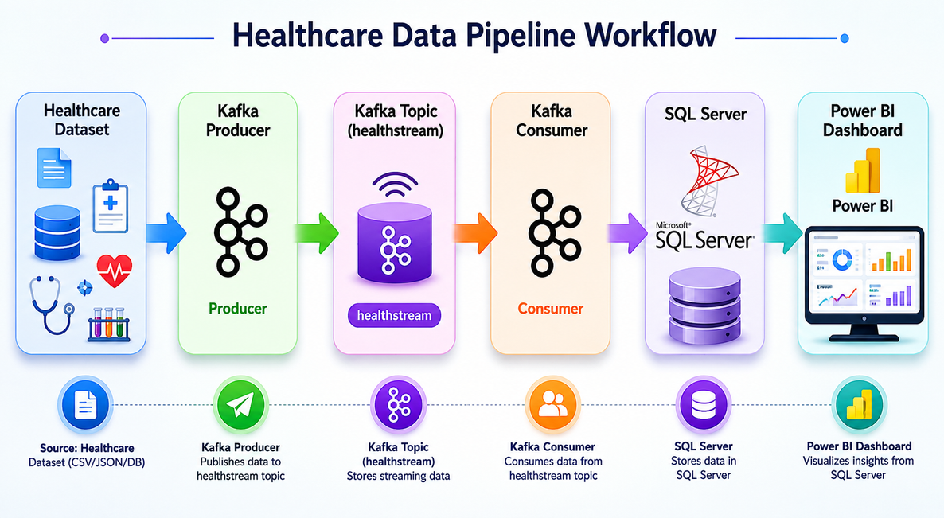
APACHE KAFKA IMPLEMENTATION
Apache Kafka was used to stream healthcare data in real time.
A Kafka Producer sent healthcare records to the healthstream topic.
A Kafka Consumer received and processed the streamed data.
The processed records were stored in SQL Server.
The stored data was visualized using Power BI dashboards.
This setup simulated a real-time telemedicine monitoring system.

Slide 9

POWER BI DASHBOARD & PROJECT RESULTS
Power BI Dashboard
Total Patients
Heart Rate Analysis
Blood Pressure Trends
Health Status Distribution
Real-Time Insights
Kafka configuration issues
SQL Server integration
Real-time synchronization

Slide 10
CONCLUSION
This project demonstrates how real-time data engineering can transform healthcare by enabling continuous patient monitoring, instant data processing, and actionable insights. By leveraging Apache Kafka, SQL Server, Streamlit, and Power BI, the system provides a scalable foundation for next-generation smart healthcare and telemedicine solutions.

Slide 11

THANK YOU

